Slide 1
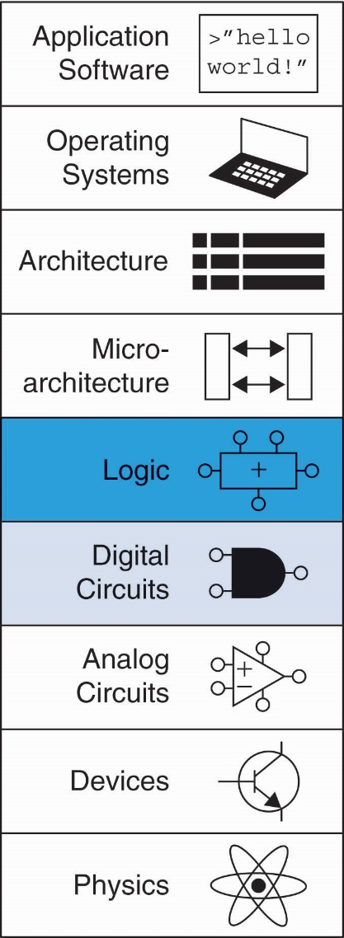
Chapter 2 :: Topics
Introduction
Logic Gates
Boolean Equations
Boolean Algebra
From Logic to Gates
Multilevel Combinational Logic
X’s and Z’s, Oh My
Karnaugh Maps
Combinational Building Blocks
Timing

Slide 2
Logic gates

Slide 3
Logic Gates
Perform logic functions:
inversion (NOT), AND, OR, NAND, NOR, etc.
Single-input:
NOT gate, buffer
Two-input:
AND, OR, XOR, NAND, NOR, XNOR
Multiple-input

Slide 4
Single-Input Logic Gates

Slide 5
Two-Input Logic Gates

Slide 6
More Two-Input Logic Gates

Slide 7
Multiple-Input Logic Gates
Multi-input XOR: Odd parity

Slide 8
Introduction
A logic circuit is composed of:
Inputs
Outputs
Functional specification
Timing specification

Slide 9
Circuits
Nodes
Inputs: A, B, C
Outputs: Y, Z
Internal: n1
Circuit elements
E1, E2, E3
Each a circuit

Slide 10
Types of Logic Circuits
Combinational Logic
Memoryless
Outputs determined by current values of inputs
Sequential Logic
Has memory
Outputs determined by previous and current values of inputs

Slide 11
Rules of Combinational Composition
Every element is combinational
Every node is either an input or connects to exactly one output
The circuit contains no cyclic paths
Example:

Slide 12
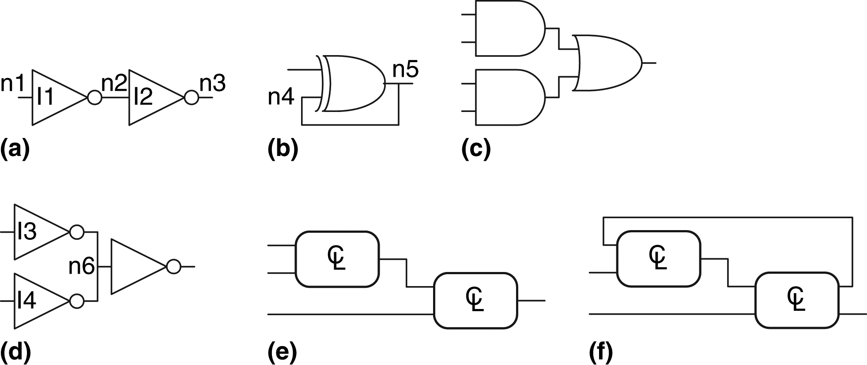
Figure 2.7 Example circuits
Check if they are combinational

Slide 13
Boolean Equations
Functional specification of outputs in terms of inputs
Example: S = F(A, B, C_{in})
C_{out} = F(A, B, C_{in})

Slide 14
Some Definitions
Complement: variable with a bar over it
A, B, C
Literal: variable or its complement
A, A, B, B, C, C
Implicant: product of literals
ABC, AC, BC
Minterm: product that includes all input variables
ABC, ABC, ABC
Maxterm: sum that includes all input variables
(A+B+C), (A+B+C), (A+B+C)

Slide 15
Sum-of-Products (SOP) Form
All equations can be written in SOP form
Each row has a minterm
Y = F(A, B) =

Slide 16
Sum-of-Products (SOP) Form
All equations can be written in SOP form
Each row has a minterm
A minterm is a product (AND) of literals
Each minterm is TRUE for that row (and only that row)
Y = F(A, B) =

Slide 17
Sum-of-Products (SOP) Form
All equations can be written in SOP form
Each row has a minterm
A minterm is a product (AND) of literals
Each minterm is TRUE for that row (and only that row)
Form function by ORing minterms where output is 1
Thus, a sum (OR) of products (AND terms)
Y = F(A, B) =

Slide 18
Sum-of-Products Form
Sum-of-Products (SOP) Form
All equations can be written in SOP form
Each row has a minterm
A minterm is a product (AND) of literals
Each minterm is TRUE for that row (and only that row)
Form function by ORing minterms where output is 1
Thus, a sum (OR) of products (AND terms)
Y = F(A, B) =

Slide 19
Sum-of-Products Form
Sum-of-Products (SOP) Form
All equations can be written in SOP form
Each row has a minterm
A minterm is a product (AND) of literals
Each minterm is TRUE for that row (and only that row)
Form function by ORing minterms where output is 1
Thus, a sum (OR) of products (AND terms)
Y = F(A, B) = AB + AB = Σ(1, 3)

Slide 20
Product-of-Sums (POS) Form
All Boolean equations can be written in POS form
Each row has a maxterm

Slide 21
Product-of-Sums (POS) Form
All Boolean equations can be written in POS form
Each row has a maxterm
A maxterm is a sum (OR) of literals
Each maxterm is FALSE for that row (and only that row)

Slide 22
Product-of-Sums (POS) Form
All Boolean equations can be written in POS form
Each row has a maxterm
A maxterm is a sum (OR) of literals
Each maxterm is FALSE for that row (and only that row)
Form function by ANDing maxterms where output is 0
Thus, a product (AND) of sums (OR terms)
Y = F(A, B) = (A + B)(A + B) = Π(0, 2)

Slide 23
Boolean Equations Example
You are going to the cafeteria for lunch
You won’t eat lunch (E)
If it’s not open (O) or
If they only serve corndogs (C)
Write a truth table for determining if you will eat lunch (E).

Slide 24
Boolean Equations Example
You are going to the cafeteria for lunch
You won’t eat lunch (E)
If it’s not open (O) or
If they only serve corndogs (C)
Write a truth table for determining if you will eat lunch (E).

Slide 25
SOP & POS Form
SOP – sum-of-products
POS – product-of-sums

Slide 26
SOP & POS Form
SOP – sum-of-products
POS – product-of-sums
E = OC
= Σ(2)
E = (O + C)(O + C)(O + C)
= Π(0, 1, 3)

